Slide 1
The Raft Consensus Algorithm
Created by: Diego Ongaro and John Ousterhout (Stanford University)

Slide 2
Why Raft?
To design an understandable consensus algorithm
To design a consensus algorithm that can be implemented in a practical system without requiring too much additional engineering

Slide 3
The Raft Consensus Algorithm
There are two types of nodes:
Leader (only one leader at a time)
Followers (multiple)
Initially, all nodes are followers.
The leader handles all client requests
Only the leader can request to write a new entry
The followers respond to the leader’s request

Slide 4
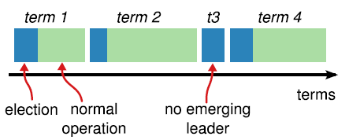
Leader election
Time is divided into terms
Each term starts with a new election
In a term, either a node becomes a leader or there is no leader for that term (no log entries are written)
Terms act as logical clock – to determine the sequence of log entries

Slide 5
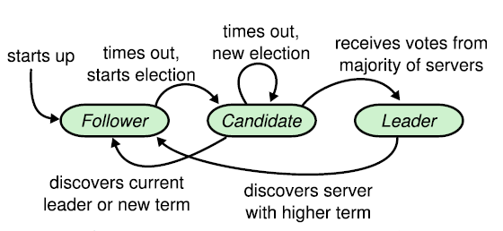
Leader election
There are three states a node can be in:
Follower
Leader
Candidate (initiates an election to become a leader)
Two types of RPCS
AppendEntries RPCs - heartbeat and log replication
RequestVote RPCs – requesting votes for being elected as leader

Slide 6
Leader election
Each node stores a current term number – increases monotonically
Initially, each node is a follower and waits for a heartbeat from the leader for a duration known as election timeout (randomly selected between 150 -300 ms)
If a node receives no hearbeat , it votes for itself, increases its CurrentTerm and sends out a RequestVote RPC to all other nodes- election initiation
If majority of nodes vote, then the candidate becomes leader.
If two nodes send out RequestVote RPC at the same time and there is no majority, no leader is elected for the term.

Slide 7
Leader election
STRONG LEADER condition: A node X votes to a RequestVote RPC only if the following hold true-
The Candidate’s current term >= X’s current term
Candidates’ log is at least as up-to-date with X’s log
Up-to-date condition is true when the last entry in Candidate’s log has a larger term number (or Candidate’s log is longer in case term numbers for last entries are similar for Candidate and X)
This Strong leader condition assures that an elected leader always has all of the entries committed in the previous term.
Therefore, leader does not need to update its log from followers.

Slide 8
Leader election
If a candidate receives any RPC while waiting for votes, it becomes a follower if the term of the sender is greater than or equal to its own currentTerm number and updates its currentTerm
Whenever a node receives an RPC with lower term number, it rejects (ignores) that RPC- ensuring stale leaders or candidates do not affect the current term
After receiving a heartbeat from leader, a follower resets its election timeout and waits for the next heartbeat
If a followers election timeout expires before it receives a heartbeat or a RequestVote RPC, it becomes a candidate and initiates an election

Slide 9
Log Replication
Raft always maintains the Log Matching Property which ensures the following-
If two entries in different logs have same index and term, then they store the same command- This is ensured by the constraint that a leader creates at most one entry with a given index in a given term.
If two entries in different logs have same index and term, then the logs are identical in all preceding entries- ensured on the follower sides with a simple consistency check performed by AppendEntries RPCs.

Slide 10
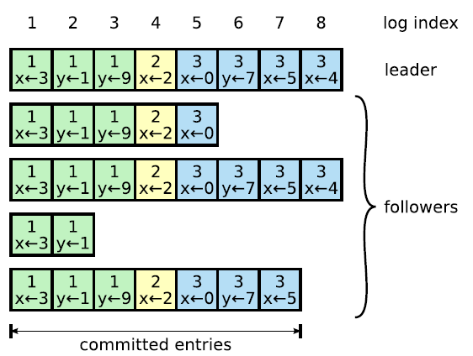
Log Replication
Log entries in Raft:

Slide 11
Log Replication
Leader Side:
On receiving a client request, the leader appends it to its own log and sends out an AppendEntries RPC in parallel to all other nodes.
AppendEntries RPCs are also used as heartbeats when sent with no new log entries.
The Leader maintains a nextIndex for each follower, which is the index of the next log entry the leader will send to that follower.
The leader sends out the index number of the last committed entry with every AppendEntries RPC, which ensures that all followers eventually learn about the commit.
Once the entry is replicated on a majority of servers, the entry is commited.
A committed entry is written to the state machine and the index of last committed is sent via future AppendEntries RPCs

Slide 12
Log Replication
Follower Side:
The AppendEntries RPCs with new log entries contain the index and term of the previous entry (X) (i.e., entry at nextIndex-1) in the Leader’s log.
The AppendEntries Consistency Check checks if the follower’s log contains an entry with X’s index and term.
If the Consistency check does not fail, the new entries are written to the follower’s log.
If the consistency check fails, then:
The Leader decrements nextIndex and retries AppendEntries RPC for that follower, until a point reaches where the logs match. (one failure of Consistency Check for each mismatching entry)
When an AppendEntries succeeds, the follower’s log is consistent with the leader’s up to that entry. (The process follows for the next entries.)

Slide 13
Log Replication
Follower Side:
If an existing entry conflicts with a new entry, the follower deletes the existing entry and all entries that follow – removing the uncommitted log entries from older terms
The follower then appends any new entries already not in the log – this is because the leader is guaranteed to have sent all previously committed log entries
If a future AppendEntries RPC says that an entry has been committed, it writes it to the State Machine

Slide 14
Log Replication
Therefore the leader does not have to take any special action to ensure log consistency.
The failed AppendEntries Consistency checks take care of maintaining consistency if logs don’t match.
There is no flow of log entries from the followers to the leader.

Slide 15
Safety
State Machine Safety Property – if a server has applied a log entry at a given index in its state machine, no other server will apply a different entry in the same index.
Ensured by the following:
A leader always contains all committed entries from previous terms
Log entries from older terms are never committed by counting replicas

Slide 16
Safety
Leader Crash Scenarios:
Leader crashes before committing an entry:
The new leader may not contain all the log entries as the majority may not have replicated
If the new leader does not contain the uncommitted entries, the client request is lost, but these entries are deleted from the followers which had replicated.
If the new leader contains the uncommitted entries, then it will try to commit them and the client request may not be lost (“may” because even this leader might fail before committing).
In both cases, there is consensus.

Slide 17
Safety
Leader Crash Scenarios:
B. Leader crashes after committing an entry, but before sending any future
AppendEntries RPC with commit information:
The majority of followers already have the entry in log
So the new leader WILL have the entry in its log
The new leader WILL try to commit it
If this leader fails, any next leader WILL ALSO have the entry in its log
The client request will not be lost and there is Consensus

Slide 18
Safety
Follower/Candidate Crash Scenario:
The RPCs are sent indefinitely by the Leader
The followers respond on starting
Gaps are filled by the consistency check.
If no leader found on starting, initiate an election.

Slide 19
Log Compaction
They use Snapshotting
Each server takes snapshots independently – When the log reaches a fixed size (predecided)

Slide 20
Limitations of Paxos (according to the authors)
Difficult to understand from a developer’s perspective
Practical implementations, more often than not, include additional modifications – resulting in final systems based on an unproven protocol
Leader is not well defined. Leader election is used for optimization instead of inherent consensus mechanism.
Every server is both a Proposer and an Acceptor
Achieving Consensus has two phases: Prepare and Accept

Slide 21
Raft Vs Paxos
Raft | Paxos
Strong leader | No leader in basic Paxos
Leader does not need to update itself | Leader updates missing entries from other nodes
Log entries move only in one direction L -> F | Log entries move in both directions L <-> F to fill holes or gaps
Practical implementations do not need much engineering | Practical implementations need significant engineering
A node is either a Leader or a Follower | All nodes are Acceptors and Proposers

Slide 22
My thoughts
The Raft algorithm seems to be more intuitive from a developer’s point of view than Paxos (having used synod and paxos once)
The fact that a leader does not need to update itself from the followers reduces some degree of complexity.
Random election timeouts ensure that multiple candidates rarely arise at the same time in practice, but there is no guarantee – two servers might independently choose the same random timeout again and again, causing elections to fail repeatedly, thus affecting availability.
Terms with no leader are a problem when time is critical- such as aviation emergencies.

Slide 23
My thoughts
An improvement may be done by introducing something when leader sends commit information to make sure that if leader fails, the other followers will have different election timeouts.
i.e, the leader for a current term will decide the order of potential leaders for the next term in case it fails, therefore removing the chance of multiple candidates in the next term.

